Slide 1

MY SQL PROJECT PRESENTATION
NAME : VIJAYASHANTHI.V
MENTOR : KAVI BHARATHI
INSTITUTE : BESANT TECH
LOCATION : BTM LAYOUT-1

Slide 2
WHAT IS SQL?
1.SQL stands for Structured Query Language
2.SQL is a standard language for storing, manipulating and retrieving data in databases.
3.SQL became a standard of the American National Standards Institute (ANSI) in 1986, and of the International Organization for Standardization (ISO) in 1987.

Slide 3
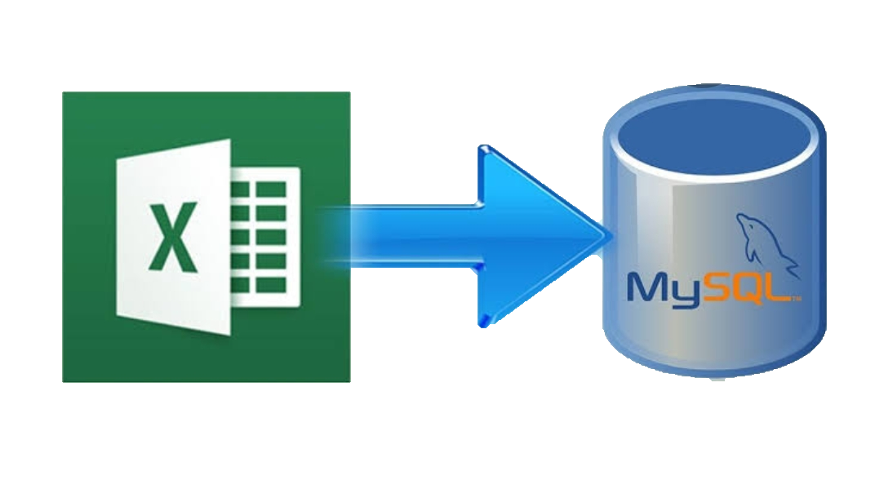
HOW TO IMPORT DATA FROM EXCEL…….

Slide 4
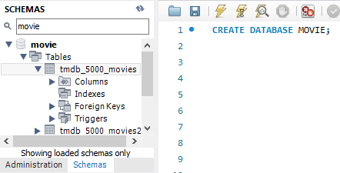
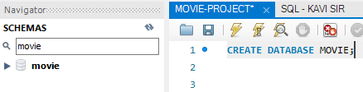
STEP BY STEP PROCEDURE OF IMPORTING EXCEL DATA TO SQL WORKBENCH
STEP-1
Create a database MOVIE.
STEP-2
Refresh the schemas.

Slide 5
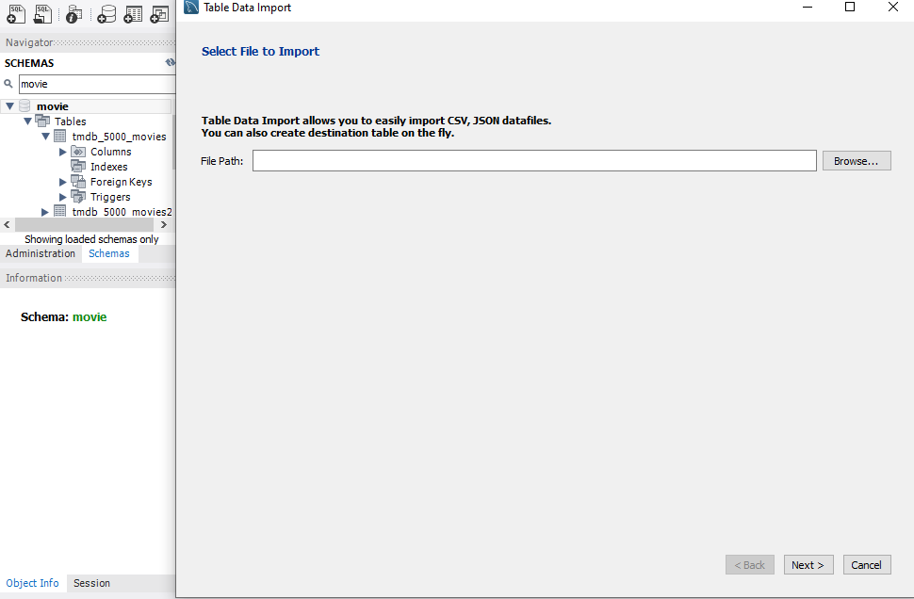
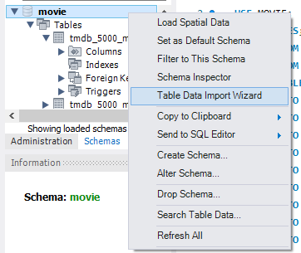
STEP-3
Right click on the Database select the Table Data Import Wizard
STEP-4
New window opens and browse the Excel Document

Slide 6
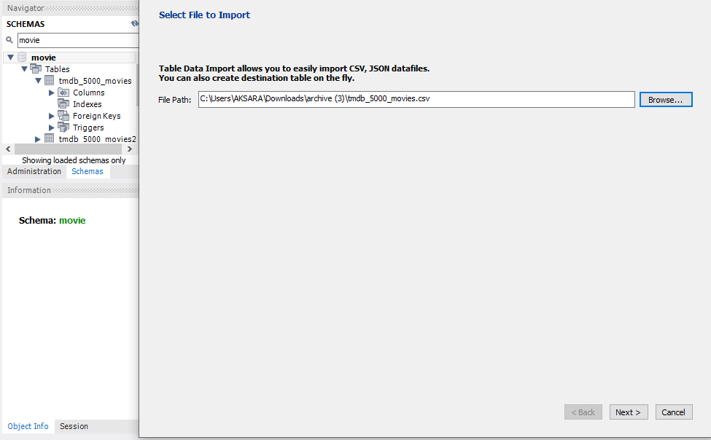
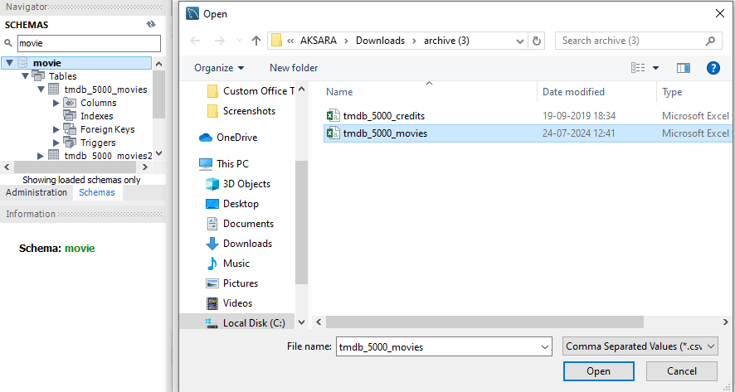
STEP-5
Select The File and Open it.
STEP-6
Click Next

Slide 7
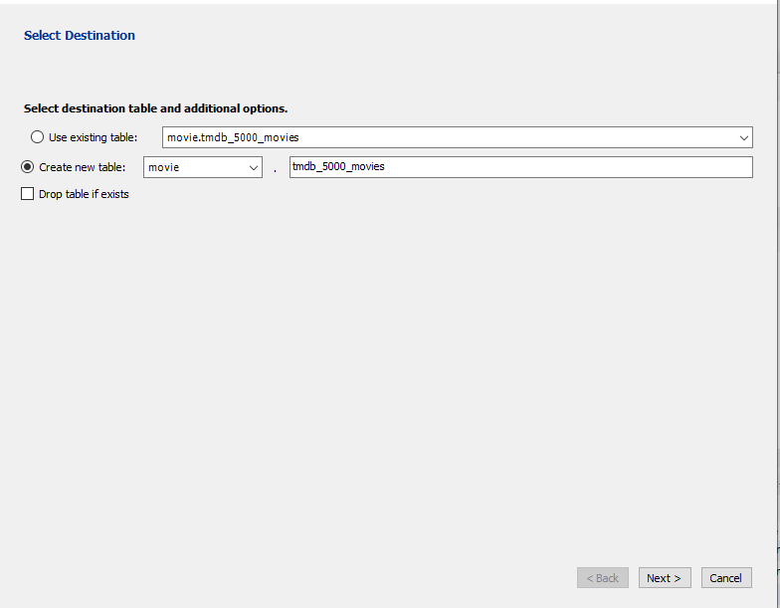
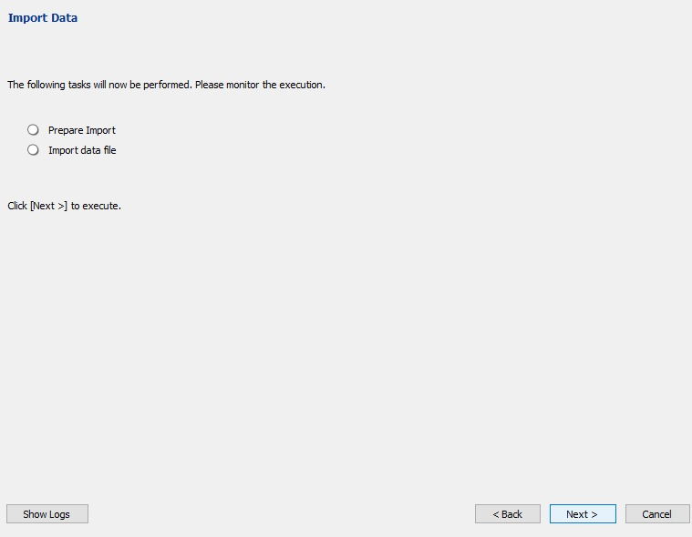
STEP-7
Click Next.
STEP-8
Click Next.

Slide 8
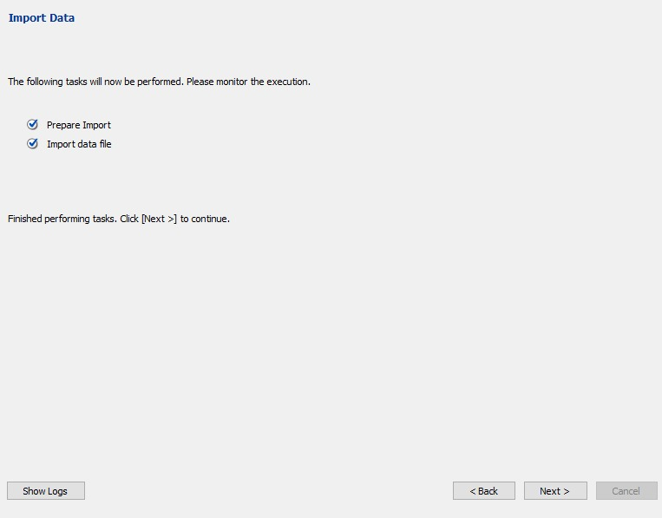
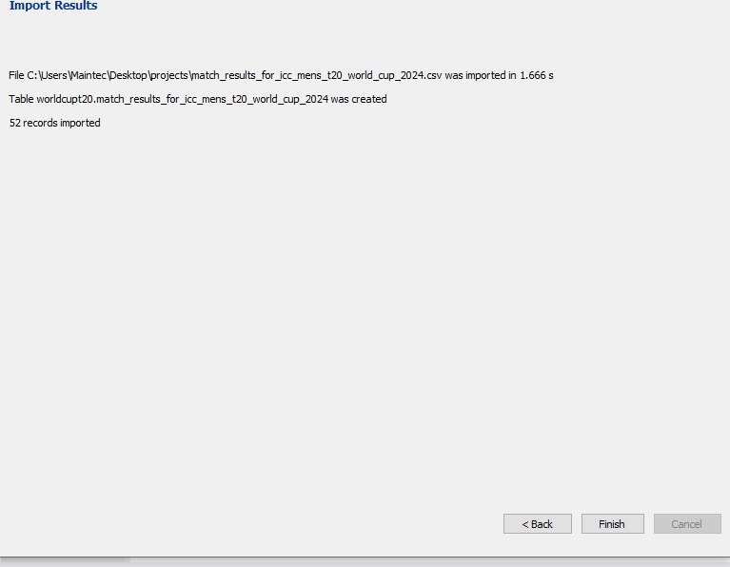
STEP-9
Once Click Next The Check Box Marked Automatically.
STEP- 10
Finally click on Finish.

Slide 9
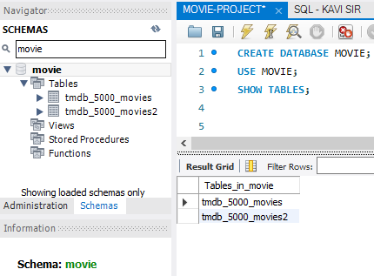
STEP-10
Just type SQL Work Bench The Syntax on “SHOW TABLES ;” The tables shown on the SQL Work Bench.

Slide 10
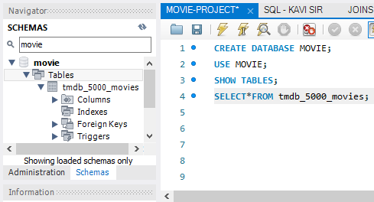
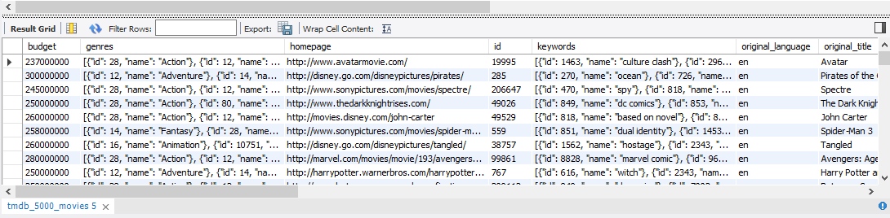
TABLE -1
STEP-11
Now the tmdb_5000_movies table has been created in your movie.
STEP-12
OUTPUT

Slide 11
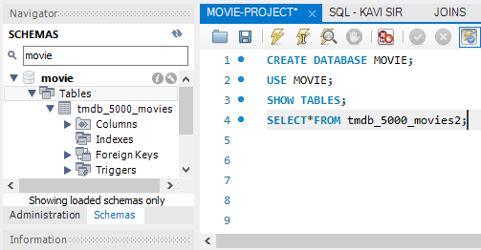
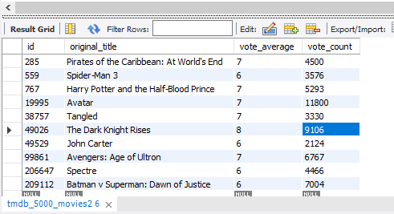
TABLE -2
STEP-13
Now the tmdb_5000_movies2 table has been created in your movie.
STEP-14
OUTPUT

Slide 12
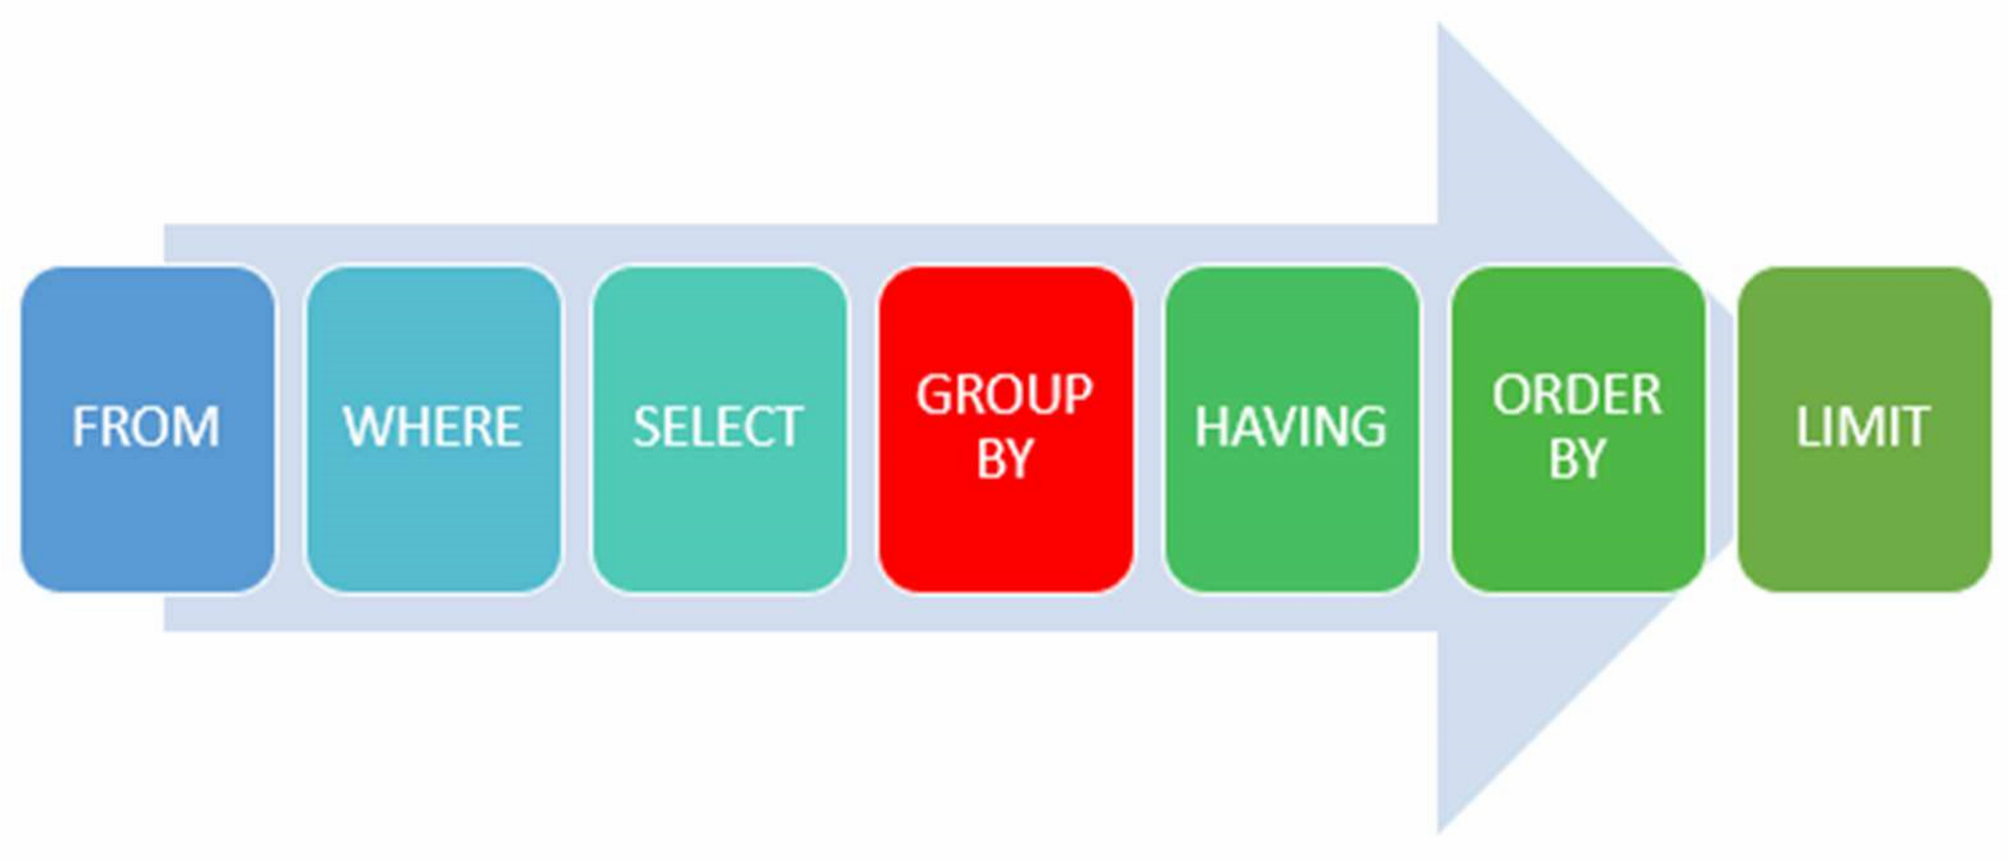
ORDER OF SQL STATEMENT

Slide 13
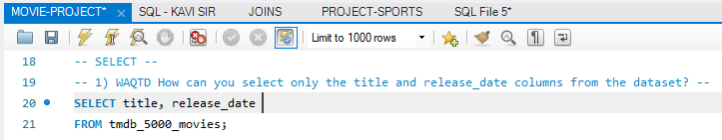
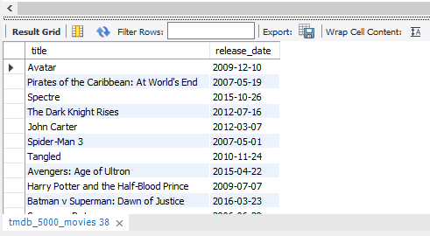
SELECT
DESCRIPTION
. It is used to access the records from one or more database tables.
. It also retrieves the selected data that follow the conditions we want.
SYNTAX
. SELECT COLUMN1,COLUMN2,…
FROM TABLE_NAME
QUERY
. WAQTD How can you select only
the title and release_date columns
from the dataset?

Slide 14
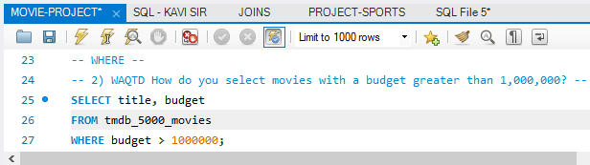
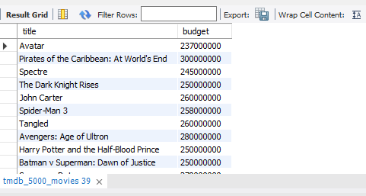
WHERE
DESCRIPTION
. A WHERE clause in SQL is a data manipulation
Language statement.
. It used to limit the number of rowa affected by a
SQL DML statement or returned by a query.
SYNTAX
. SELECT COLUMN1,COLUMN2,…
FROM TABLE_NAME
WHERE CONDITION;
QUERY
. How do you select movies with a budget
greater than 1,000,000?

Slide 15
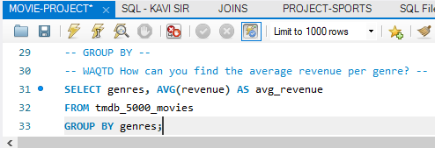
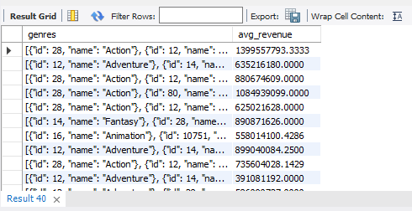
GROUP BY
DESCRIPTION
. The MYSQL GROUP BY Clause is used to collect
data from multiple records and group the result
by one or more column. It is generally used in a
SELECT statement.
SYNTAX
. SELECT COLUMN_NAME(S)
FROM TABLE_NAME
WHERE CONDITION
GROUP BY COLUMN_NAME(S)
ORDER BY COLUMN_NAME(S);
QUERY
. How can you find the average revenue
per genre?

Slide 16
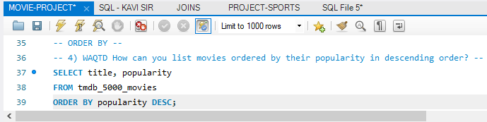
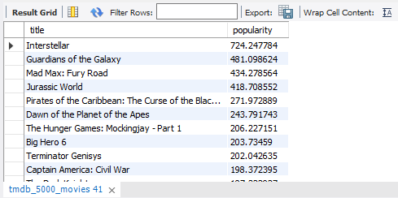
ORDER BY
DESCRIPTION
. The ORDER BY clause in SQL helps us sort the
records based on a table’s specific column.
. We can sort the records in ascending or
descending order as per our requirement.
SYNTAX
. SELECT COLUMN1,COLUMN2,…
FROM TABLE_NAME
ORDER BY COLUMN1,COLUMN2,…
ASC (or) DESC
QUERY
. WAQTD How can you list movies
ordered by their popularity in
descending order?

Slide 17
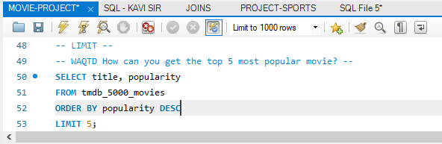
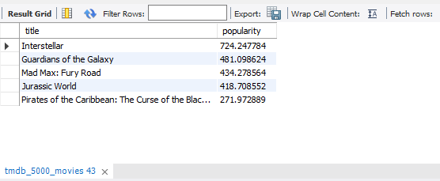
LIMIT
DESCRIPTION
. The LIMIT clause in the select statement is used to
limit the number of rows returned.
. AS A RESULT, The LIMIT clause should always
be used with an order-by clause to ensure that the
expected output is produced.
SYNTAX
. SELECT list
FROM table_name
GROUP BY sort_column_name
QUERY
. WAQTD How can you get the top 5
most popular movie?

Slide 18
AGGREGATE FUNCTIONS
DESCRIPTION
. Aggregate functions are often used with the GROUP BY
clause of the SELECT statement.
. The GROUP BY clause splits the result-set into groups of
values and the aggregate function can be used to return a
single value for each group.

Slide 19
AGGREGATE FUNCTIONS
The most commonly used SQL aggregate functions are:
. MIN() – returns the smallest value within the selected column
. MAX() – returns the largest value within the selected column
. COUNT() – returns the number of rows in a set
. SUM() – returns the total sum of a numerical column
. AVG() – returns the average value of a numerical column
. Aggregate functions ignore null values (except for COUNT()).

Slide 20
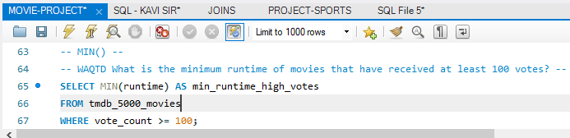
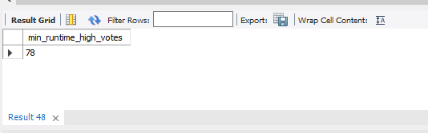
MIN() FUNCTIONS
DESCRIPTION
. The MIN function in SQL is used to return the
highest value in a column for a group of rows.
SYNTAX
. SELECT MIN(column_name)
FROM table_name;
QUERY
. WAQTD What is the minimum runtime
of movies that have received at least 100
votes?

Slide 21
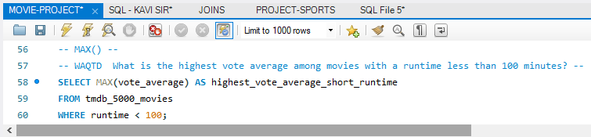
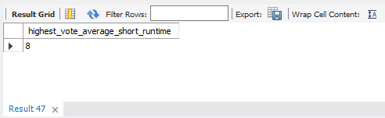
MAX() FUNCTIONS
DESCRIPTION
. The MAX function in SQL is used to return the
highest value in a column for a group of rows.
SYNTAX
. SELECT MAX(column_name)
FROM table_name;
QUERY
. WAQTD What is the highest vote
average among movies with a runtime
less than 100 minutes?

Slide 22
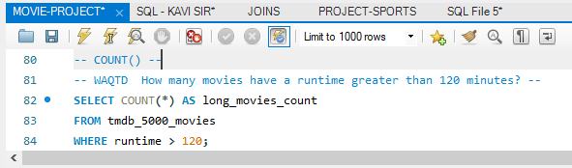
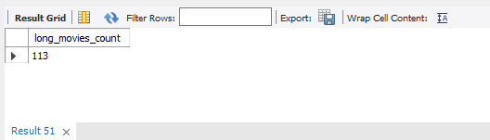
COUNT() FUNCTIONS
DESCRIPTION
. The COUNT function in SQL is used to return the
highest value in a column for a group of rows.
SYNTAX
. SELECT COUNT(column_name)
FROM table_name;
QUERY
. WAQTD How many movies have a
runtime greater than 120 minutes?

Slide 23
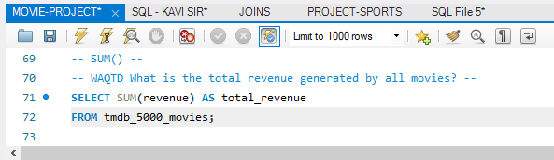
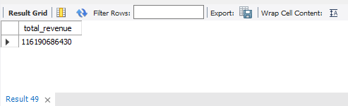
SUM() FUNCTIONS
DESCRIPTION
. The SUM function in SQL is used to return the
highest value in a column for a group of rows.
SYNTAX
. SELECT SUM(column_name)
FROM table_name;
QUERY
. WAQTD What is the total revenue
generated by all movies?

Slide 24
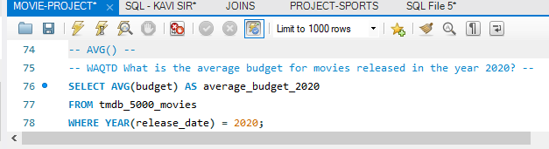
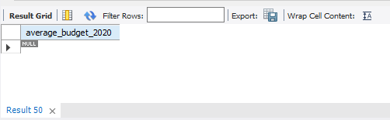
AVG() FUNCTIONS
DESCRIPTION
. The AVG function in SQL is used to return the
highest value in a column for a group of rows.
SYNTAX
. SELECT AVG(column_name)
FROM table_name;
QUERY
. WAQTD What is the average budget for
movies released in the year 2020?

Slide 25
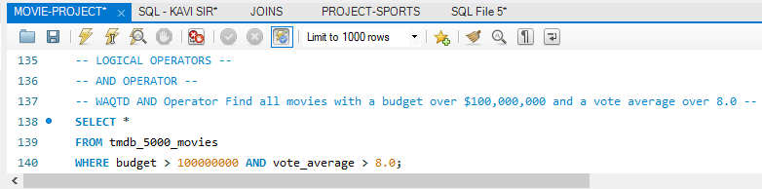
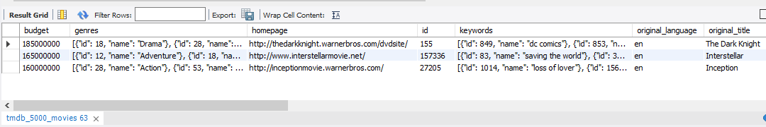
LOGICAL OPERATORS:
AND - OPERATOR
DESCRIPTION
. It is used to write multiple condition in
where class.
. Two condition is true then satisfied.
SYNTAX
. SELECT column1, Column N
FROM table_Name
WHERE condition1
AND condition2
AND condition3;
QUERY
. WAQTD AND operator find all movies
with a butget over $100,000,000 and a
vote average over 8.0?

Slide 26
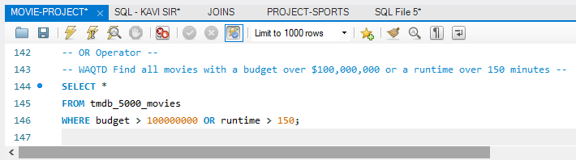
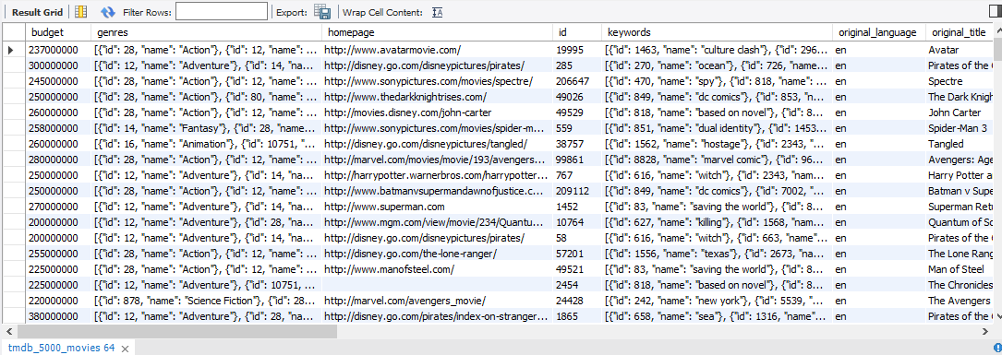
OR - OPERATOR
DESCRIPTION
. If any one of the condition is satisfied
it will return true.
SYNTAX
. SELECT column1, Column N
FROM table_Name
WHERE condition1
OR condition2
OR condition3
OR condition N;
QUERY
. WAQTD Find all movies with a budget
over $100,000,000 or a runtime over
150 minutes?

Slide 27
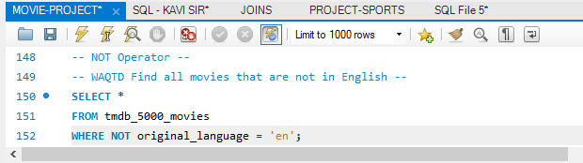
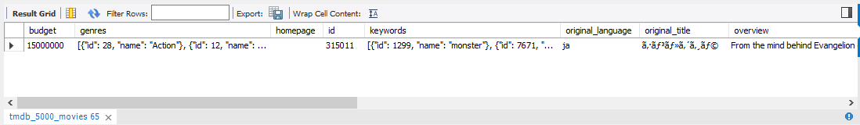
NOT - OPERATOR
DESCRIPTION
. NOT operator is inverse operator using not
keyword.
SYNTAX
. SELECT column1, Column 2,…
FROM table_Name
WHERE NOT condition;
QUERY
. WAQTD Find all movies that are not in
English.

Slide 28
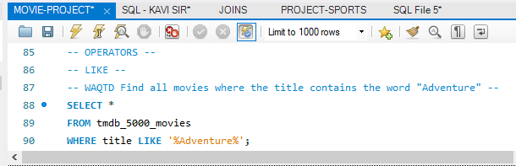
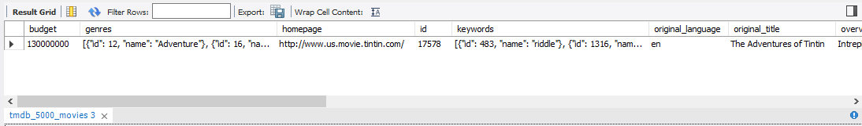
SPECIAL OPERATORS:
LIKE
DESCRIPTION
. It filters the records from the columns based on the
pattern specified in the SQL query it will denoted
to % or _.
SYNTAX
. SELECT column1, ColumN 2,…
FROM table_Name
WHERE condition N LIKE pattern;
QUERY
. WAQTD Find all movies where the tittle
contains the word “adventure”?

Slide 29
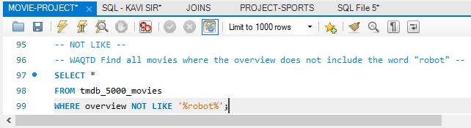
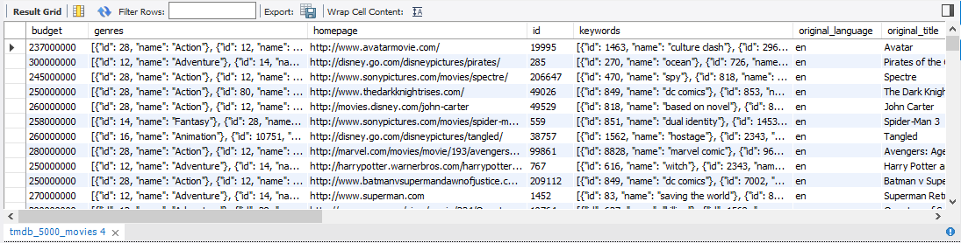
NOT LIKE
DESCRIPTION
. The NOT LIKE operator is used to find records that
do not match a specific pattern.
. It is the opposite of the LIKE operator.
SYNTAX
. SELECT column_name
FROM table_name
WHERE column_name NOT LIKE pattern;
QUERY
. WAQTD Find all movies where the
overview does not include the word “robot”?

Slide 30
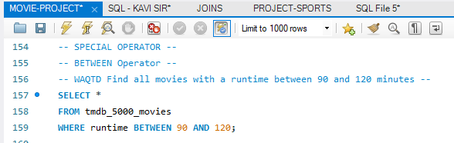
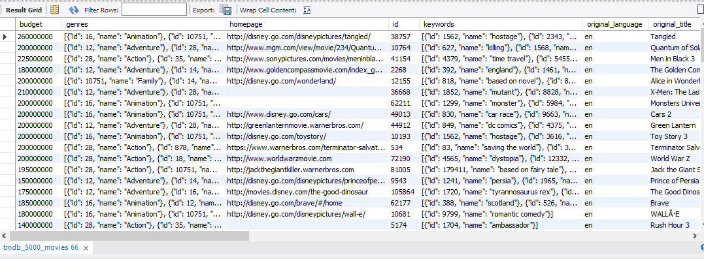
BETWEEN
DESCRIPTION
. The BETWEEN operator in SQL is used to select values
within a given range.
. It is inclusive, meaning it includes the boundary values.
SYNTAX
. SELECT column_name
FROM table_name
WHERE column_name
BETWEEN volue 1 and volue 2;
QUERY
. WAQTD Find all movies with a runtime
between 90 and 120 minutes?

Slide 31
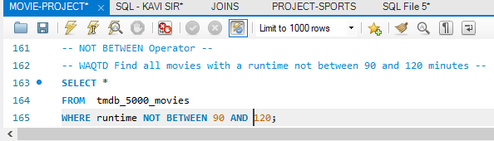

NOT BETWEEN
DESCRIPTION
. The NOT BETWEEN operator in SQL is used to select
values outside a given range.
. It is inclusive, meaning it excludes the boundary values.
SYNTAX
. SELECT column_name
FROM table_name
WHERE column_name
NOT BETWEEN volue 1 and volue 2;
QUERY
. WAQTD Find all movies with a runtime
not between 90 and 120 minutes?

Slide 32

SUB-QUERIES
DESCRIPTION
. i) In a query will execute first produce output.
ii) Output of inner query will be past as input of outer query.
iii) Then the outer query will process the complete result.
iv) Inner query is completely depends on outer query.
v) It may be have two cases case-I and case-II.

Slide 33


SUB QUERY CASE - I
DESCRIPTION
. A single-row sub query returns only one row and one
column.
. It's used to compare a value from the main query with a
single value returned by the sub query.
SYNTAX
. SELECT column1, column2, ...
FROM table
WHERE column name
OPERATOR
(SELECT column name
FROM table
WHERE condition);
QUERY
. WAQTD Production countries: Movies
Produced in the same country as the
movie with maximum revenue?

Slide 34


SUB QUERY CASE - II
DESCRIPTION
. A multiple-row sub query returns more than one row and
is used to compare a value from the main query with
multiple values returned by the sub query.
SYNTAX
. SELECT column1, column2, ...
FROM table1
WHERE column name
OPERATOR
(SELECT column name
FROM table2
WHERE condition);
QUERY
. WAQTD Homepage: Movies with a
Homepage and Popularity Higher than
the average?

Slide 35


NESTED SUB QUERY
DESCRIPTION
. A nested sub query is a sub query that contains another
sub query.
. The inner sub query is evaluated first, and its results are
used by the outer sub query.
SYNTAX
. SELECT column1, column2, ...
FROM table1
WHERE column name
OPERATOR (SELECT column name
FROM table2 WHERE column name
OPERATOR (SELECT column name
FROM TABLE3 WHERE condition);
QUERY
. WAQTD ID: Movies with IDs Higher
than the average ID of movies Released
after 2010?

Slide 36

JOINTS
DESCRIPTION
. SQL JOIN clause is used to query and access data from
multiple tables by establishing logical relationships
between them.
. It can access data from multiple tables simultaneously
using common key values shared across different tables.
. We can use SQL JOIN with multiple tables.
. It can also be paired with other clauses, the most popular
use will be using JOIN with WHERE clause to filter data
retrieval.
I) Cartesian Join
II) Inner Join
III) Outer Join
IV) Self Join
V) Natural Join.
TYPES OF JOINS

Slide 37

INNER JOINS
DESCRIPTION
. Inner join retrives the rows that match from the left and
right tables. If there are no matching rows,NULL is
displayed.
SYNTAX
. SELECT *
FROM table1
INNER JOIN table2
ON join_predicate
QUERY
. WAQTD Query will select all details from
the both the tmdb_5000_movies and
tmdb_5000_movies2 tables where the movie
column matches in both tables?

Slide 38

OUTER JOINS
DESCRIPTION
. Used to fetch the unmatched records from tables.
TYPES
. I) RIGHT OUTER
. II) LEFT OUTER
. III) FULL OUTER
LEFT OUTER
. Used to fetch the unmatched records of the table
along with matched records.
SYNTAX
. SELECT *
FROM table1
INNER JOIN table2 ON CONDITION.
QUERY
. WAQTD Query to find the details of
tmdb_5000_movies and tmdb_5000_movies2 tables
where the movie column matches in both tables?

Slide 39

RIGHT OUTER
RIGHT JOIN
DESCRIPTION
. Used to fetch the unmatched records of the tables,
along with matched records.
SYNTAX
. SELECT *
FROM table1
RIGHT JOIN table2
ON CONDITION.
QUERY
. WAQTD Query to find the details of
tmdb_5000_movies and tmdb_5000_movies2 tables
where the movie column matches in both tables?

Slide 40

SELF JOIN
DESCRIPTION
. A Self-join is a type of join where a table
is joined with itself. This is useful for
comparing or combining rows within
the table.
SYNTAX
. SELECT * FROM table name AS
alias1 INNER JOIN table name AS
alias2 ON alias1.column name =
alias2.column name;
QUERY
. WAQTD Query to find the details of
tmdb_5000_movies and tmdb_5000_movies2 tables
where the movie column matches in both tables?

Slide 41


SINGLE ROW FUCNTIONS
LENGTH():
DESCRIPTION
. The LENGTH() function in SQL returns the number
of characters in a string.
SYNTAX
. SELECT column1, ColumN 2,…
FROM
QUERY
. WAQTD Keywords: Find the Length of
the Keywords Field?

Slide 42
CONCLUSION
. SQL is a powerful tool for data analysis and manipulation, and it
plays a crucial role in various data science projects.
. Through exploring top SQL database project, we have seen how
it can tackle real-world challenges and gain valuable insights
from diverse datasets.

